Slide 1
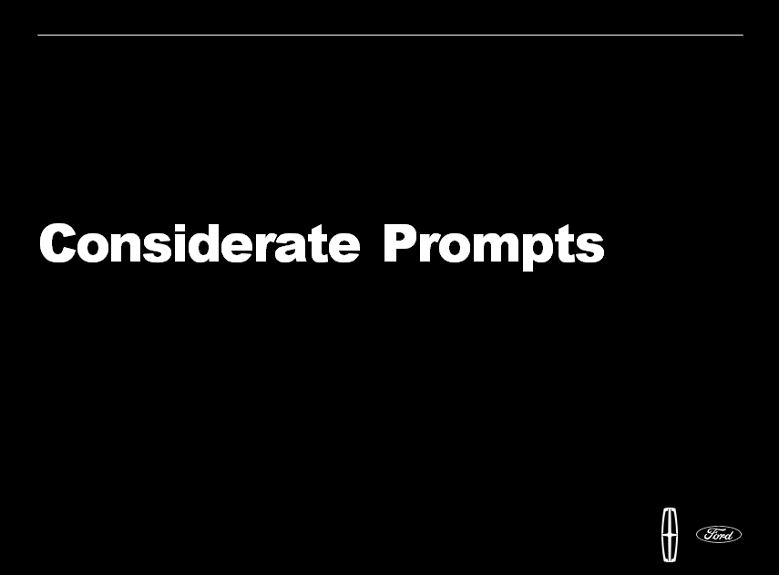
Cesar Gonzalez
Feature Owner

Slide 2
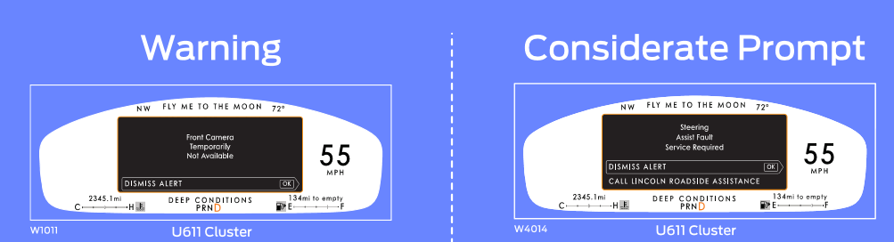
Steering Fault Service Now
Steering Fault Service Now
W140
W4012

Slide 3



Considerate Prompts: 3 warning categories
SYNC 4.0 QNX ✓
SYNC 4.0 Phoenix 🗙
SYNC 4.0 QNX ✓
SYNC 4.0 Phoenix ✓
SYNC 4.0 QNX ✓
SYNC 4.0 Phoenix ✓
Purpose and Overview of Feature
The purpose of this feature is to assist driver with displaying additional actionable option when any vehicle warning triggered. Feature will categorize the warning in different type and driver will get a list of relevant POIs or call Ford/Lincoln Roadside Assistance depending on warning type. In addition to warning display, new situational prompt will assist driver to change digital speedometer unit when certain conditions meet.

Slide 4
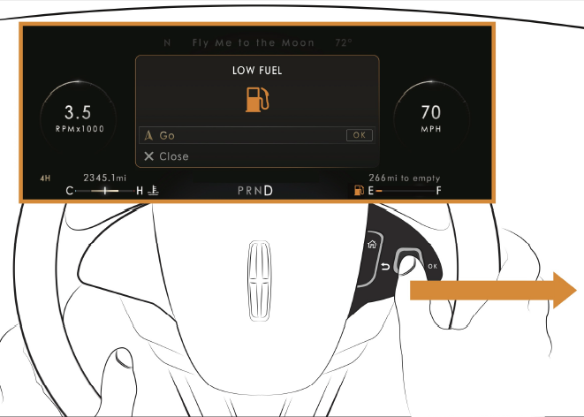
POI Warning Example
Function will not be present in SYNC 4.0
Phoenix due Google Automotive Service
Nearest Fuel Station

Slide 5
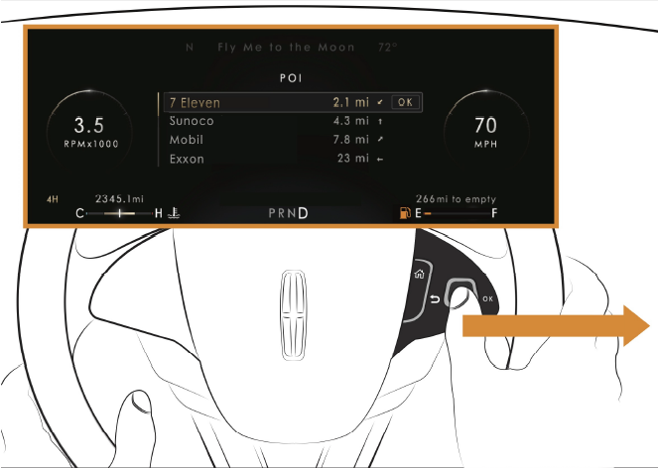
POI Warning Example
Function will not be present in SYNC 4.0
Phoenix due Google Automotive Service

Slide 6
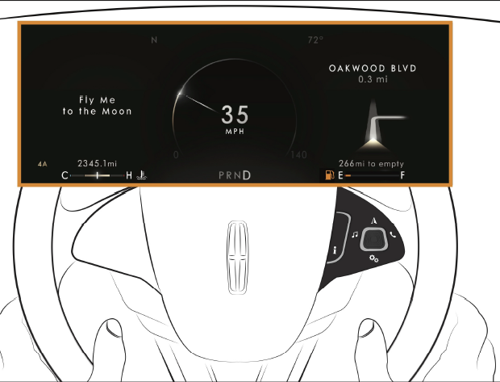
POI Warning Example
Function will not be present in SYNC 4.0
Phoenix due Google Automotive Service

Slide 7
POI Warning message list [1/2]
Non considerate prompt [GML id] | Representative text | Considerate prompt Lincoln [GML id] | Representative text
W3276 | Charging System Service Now | W4015 | Charging System Service Now Dismiss Alert Nearest Fuel Stations
W381 | Tire Pressure Low {Graphic} | W4000 | Tire Pressure Low {Graphic} Dismiss Alert Nearest Fuel Stations
W1817 | Depleted Battery Stop safely now | W4270 | Depleted Battery Dismiss Alert Nearest Charging Station
W1816 | Low Battery Reduce Climate use for more range | W4271 | Low Battery Reduce Climate use for more range Dismiss Alert Nearest Charging Station
W1815 | Low Battery | W4272 | Low Battery Dismiss Alert Nearest Charging Station
Function will not be present in SYNC 4.0
Phoenix due Google Automotive Service

Slide 8
POI Warning message list [2/2]
Non considerate prompt [GML id] | Representative text | Considerate prompt Lincoln [GML id] | Representative text
W224 | Fuel Level Low {#0} Miles to Empty | W4001 | Fuel Level Low {#0} Miles to Empty Dismiss Alert Nearest Fuel Stations
W225 | Fuel Level Low {##0} km to Empty | W4002 | Fuel Level Low {##0} km to Empty Dismiss Alert Nearest Fuel Stations
W450 | Washer Fluid Level Low | W4005 | Washer Fluid Level Low Dismiss Alert Nearest Fuel Stations
- | - | W4025 | Nearest Fuel Stations Exit {Fuel Station 1, #0 mi, Arrow} {Fuel Station 2, #0 mi, Arrow} {Fuel Station 3, #0 mi, Arrow} {Fuel Station 4, #0 mi, Arrow}
- | - | W4382* | Nearest Charging Stations Exit {Charging Station 1, #0 mi, Arrow} {Charging Station 2, #0 mi, Arrow} {Charging Station 3, #0 mi, Arrow} {Charging Station 4, #0 mi, Arrow}
Function will not be present in SYNC 4.0
Phoenix due Google Automotive Service

Slide 9
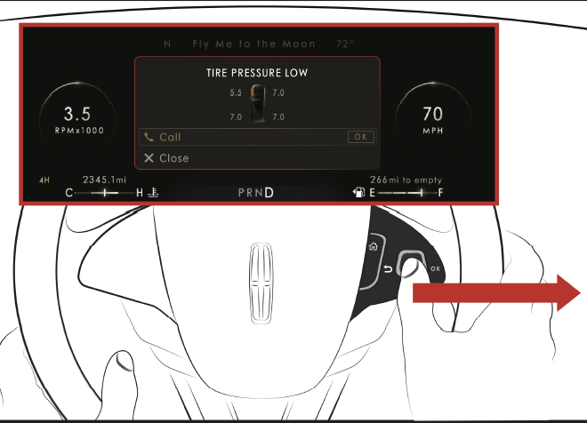
Roadside Type Warning Example
Steering Fault Service Now
Dismiss Alert Call Lincoln Roadside Assistance
Lincoln Numbers to call
US: 1-800-521-4140
Canada: 1-800-387-9333
Ford Numbers to call
US: 1-800-241-3673
Canada: 1-800-665-2006
France: 0 800 005 005
UK: 0 800 111 234

Slide 10
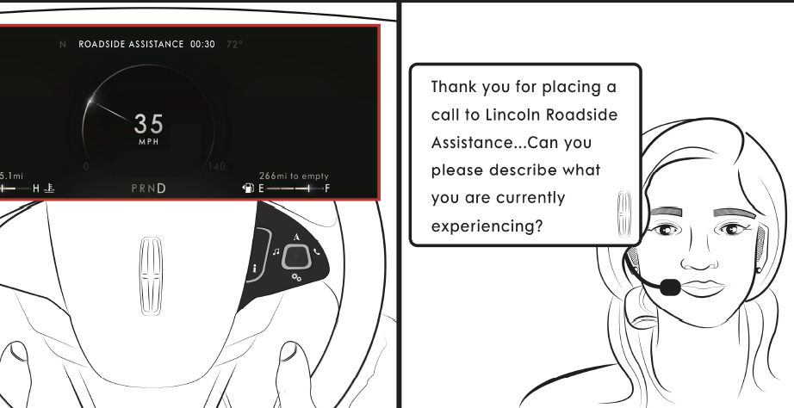
Roadside Type Warning Example
Call is placed following “Call Strategy”, Phone paired via Bluetooth

Slide 11
Call Ford/Lincoln Roadside Assistance Warning message list [1/2]
Non considerate prompt [GML id] | Considerate prompt Lincoln [GML id] | Considerate prompt Ford [GML id]
W140 Steering Fault Service Now | W4012 (L) Steering Fault Service Now Dismiss Alert Call Lincoln Roadside Assistance | W4220 (F) Steering Fault Service Now Dismiss Alert Call Roadside Assistance
W141 Steering Loss Stop Safely | W4013 (L) Steering Loss Stop Safely Dismiss Alert Call Lincoln Roadside Assistance | W4221 (F) Steering Loss Stop Safely Dismiss Alert Call Roadside Assistance
W142 Steering Assist Fault Service Required | W4014 (L) Steering Assist Fault Service Required Dismiss Alert Call Lincoln Roadside Assistance | W4222 (F) Steering Assist Fault Service Required Dismiss Alert Call Roadside Assistance
W1484 Transmission Over Temperature Stop Safely | W4018 (L) Transmission Over Temperature Stop Safely Dismiss Alert Call Lincoln Roadside Assistance | W4223 (F) Transmission Over Temperature Stop Safely Dismiss Alert Call Roadside Assistance
W1485 Transmission Fault Service Now | W4019 (L) Transmission Fault Service Now Dismiss Alert Call Lincoln Roadside Assistance | W4224 (F) Transmission Fault Service Now Dismiss Alert Call Roadside Assistance
Phone numbers different between Ford/Lincoln

Slide 12
Call Ford/Lincoln Roadside Assistance Warning message list [2/2]
Non considerate prompt [GML id] | Considerate prompt Lincoln [GML id] | Considerate prompt Ford [GML id]
W1487 Transmission Service Required | W4020 (L) Transmission Service Required Dismiss Alert Call Lincoln Roadside Assistance | W4225 (F) Transmission Service Required Dismiss Alert Call Roadside Assistance
W1534 Transmission Overheating Stop Safely | W4021 (L) Transmission Overheating Stop Safely Dismiss Alert Call Lincoln Roadside Assistance | W4226 (F) Transmission Overheating Stop Safely Dismiss Alert Call Roadside Assistance
W1591 Transmission Limited Function See Manual | W4022 (L) Transmission Limited Function See Manual Dismiss Alert Call Lincoln Roadside Assistance | W4227 (F) Transmission Limited Function See Manual Dismiss Alert Call Roadside Assistance
W2127 Adaptive Steering Loss Do Not Drive | W4023 (L) Adaptive Steering Loss Do Not Drive Dismiss Alert Call Lincoln Roadside Assistance | W4228 (F) Adaptive Steering Loss Do Not Drive Dismiss Alert Call Roadside Assistance
Phone numbers different between Ford/Lincoln

Slide 13
Speedometer Unit Change Warning Example
Border Crossing
Match Speed Units to Road Signs ?
Dismiss Alert
Change Speedometer Units
GML id | Representative text
W4024 | Border Crossing Match Speed Units to Road Signs ? Dismiss Alert Change Speedometer Units

Slide 14
Unit Change Settings Example
Settings Menu
Reminder OFF
Reminder ON

